Slide 1
Implementing a pipeline

Slide 2
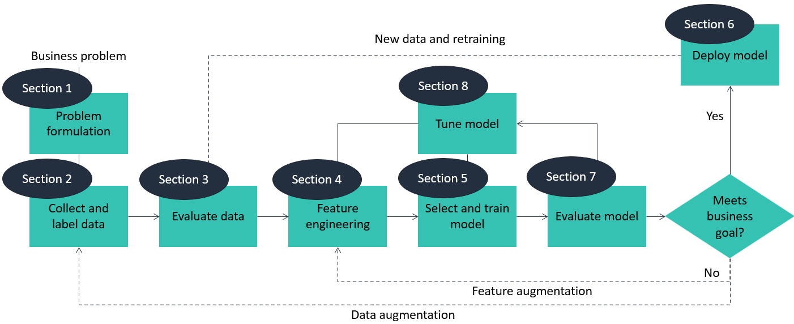
First do module 3 on AWS
Notes:
It’s long and hard, but also very important.

Slide 3
First do module 3 on AWS
Section 1: Nice to know, you did the exercises before
Section 2:
Nice to know, but try to keep track of all the AWS-lingo
No exercises in the folder, tryout amazon Sagemaker
Section 3:
Need to know, but really “should already know”
Introduces pandas! (entire section should be very familiar)
Also talks about correlation, which will be a main topic later on here
Also do the sagemaker lab

Slide 4
First do module 3 on AWS
Section 4:
Need to know
Dive deeper into pandas, but more on data than section 3
Section 5:
Need to know
You can ignore the models for now (XGBoost, linear learner, K-means) as they’ll be covered later in this ppt
Section 6:
Need to know, but short

Slide 5

First do module 3 on AWS
Section 7:
Need to know
First confusion matrix and ROC-curves, but not the last
A difficult section, take your time for it
Section 8:
Nice to know, hyper parameter tuning only works if you know what you are tuning
You can’t make a car go faster by randomly screwing and unscrewing bolts in your engine
It’s not something you will learn in 7 slides
But you need to know it exists!

Slide 6

Covariation and correlation
You already know this part
You learned it in at least one other course before
Try not to fall asleep

Slide 7
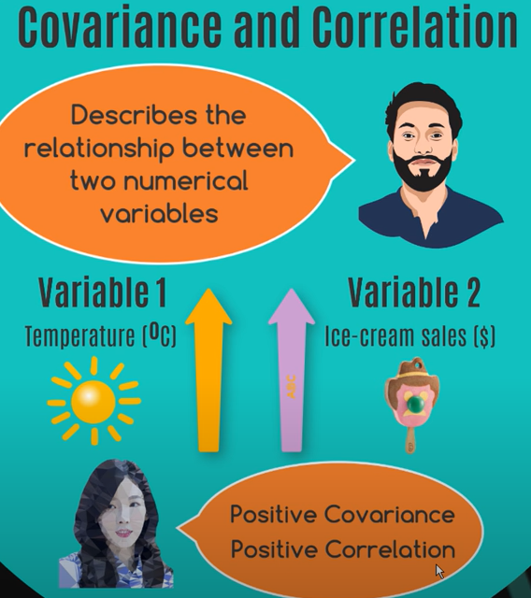
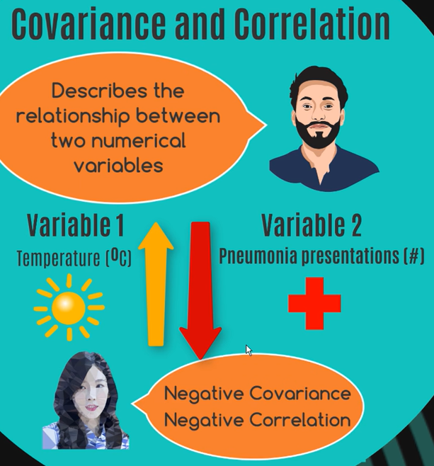
Covariation

Slide 8
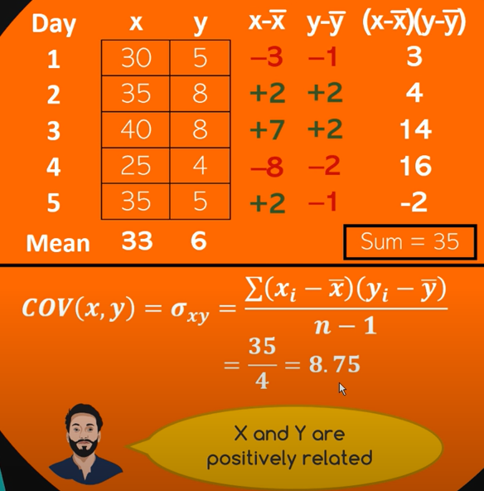
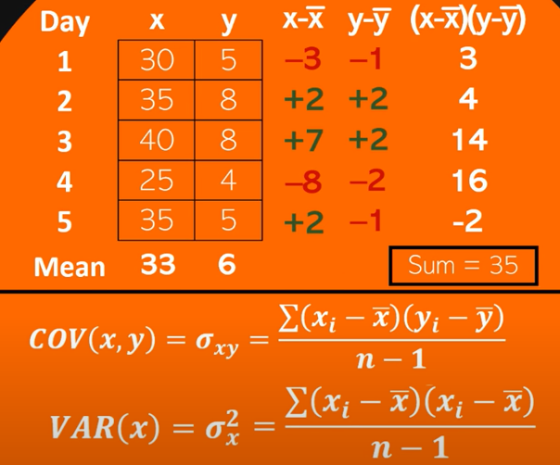
Using math
Notes:
https://www.youtube.com/watch?v=mG__Wpp9dns&ab_channel=zedstatistics

Slide 9
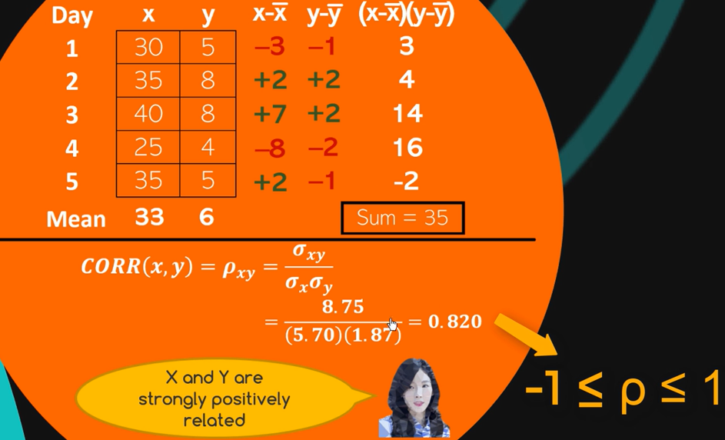

Correlation = measure of strength

Slide 10
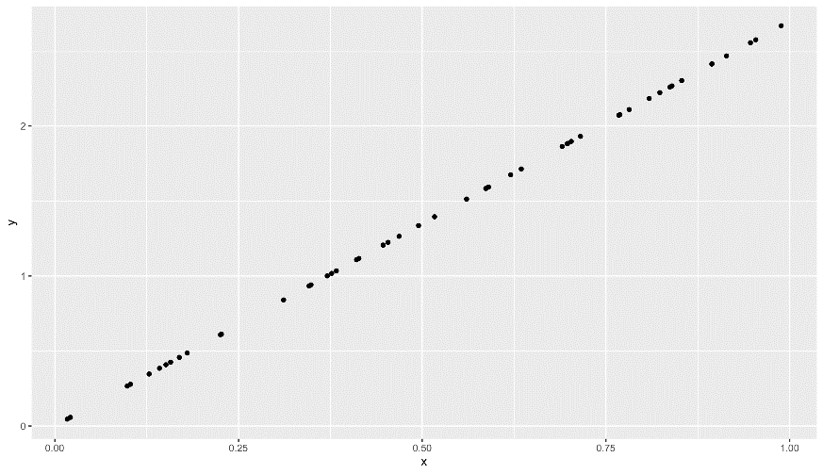
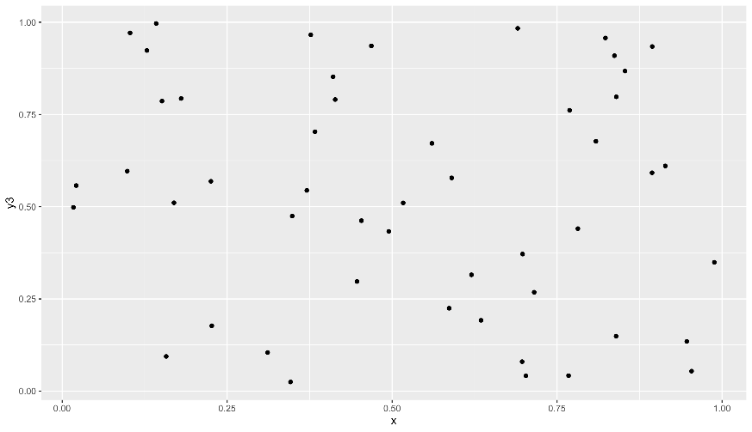
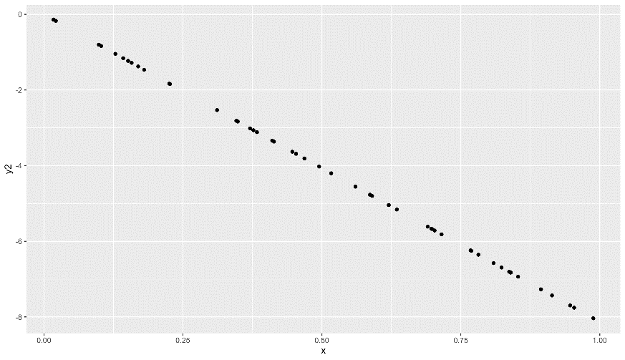
Extremes of correlation
Correlation = 1 Perfect positive relationship
Correlation = 0
No pattern
Correlation = -1
Perfect negative relationship

Slide 11
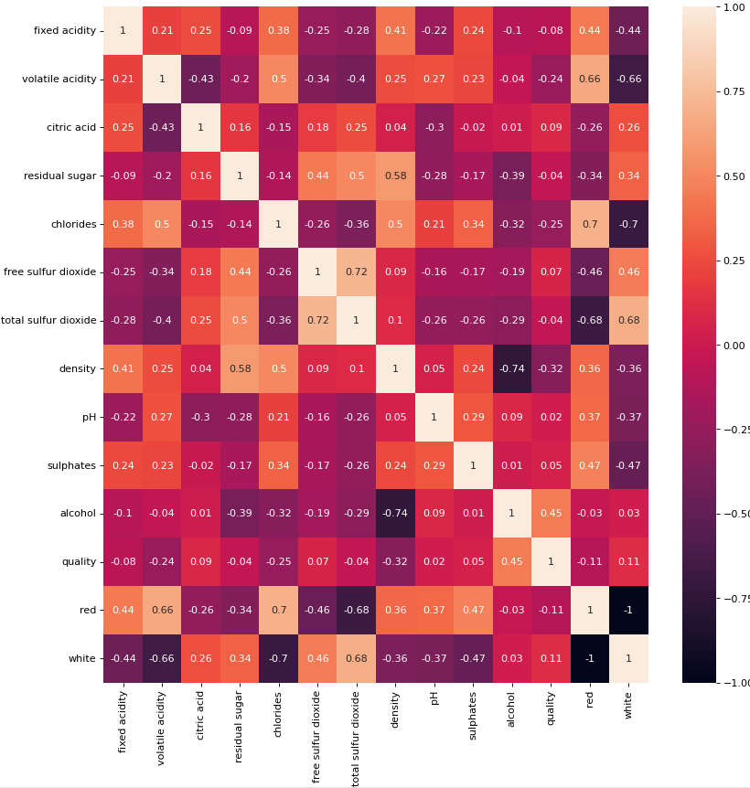
But how and why?
Look at the correlation heatmap of the wine dataset
Can you find fields which rise together?
And fields that rise oppositely?
Generating this is a function in pandas…
Making a nice graph of it is seaborn
Notes:
High correlated features express the same kind of knowledge. If you want to model the data, best to prune one away, otherwise your model might be biased towards that part of the data (because it’s given to the model twice)

Slide 12
Correlation in models
Suppose feature A strongly correlates with B and C, but feature X correlates with no others
When training an unsupervised model, whatever makes A, B and C go up (or down) will have three times as much influence on the outcome as whatever makes X move
Knowing where the correlations are is important to explain the dataset
Which is why we covered it in the Data Science-course
But it is also important when training a model
Don’t include multiple highly correlated features

Slide 13
2023-2024
There’s a bit of a problem…
You guys get AI in 3ITF, but the next gen ITF will have it in 2ITF
So they will already know machine learning, but you’ll be learning it this week and next week
But we’re handling it:
This slide references some of the same stuff you get in the AI-course
Discussion topics here are focused on how to run models in SageMaker

Slide 14

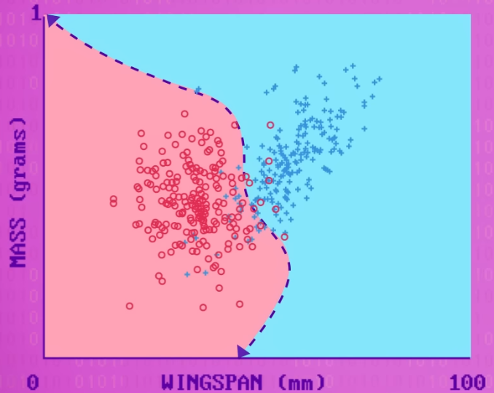
Machine learning
You remember this video, right?
https://www.youtube.com/embed/z-EtmaFJieY?start=3&end=335
(Also note the confusion matrix we’ll be talking about next!)
So what we are doing is having the computer make this
But with more features and a better output
The models we’ll be looking at:
XGBoost, linear learner, K-means

Slide 15
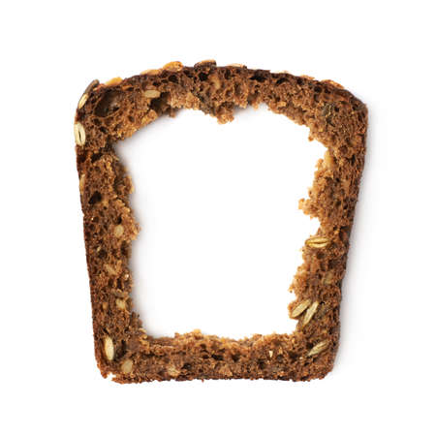
No slide (or slice)
Read 3.1 – XGBoost.md
Read 3.2 – Linear learner.md
Read 3.3 – K-means.md

Slide 16
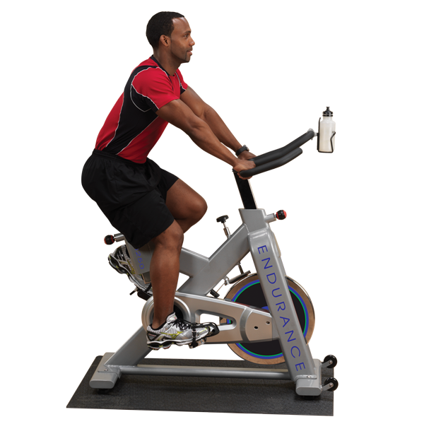
You are now ready for the sample notebooks-exercises now. It’s in the “exercises”-folder, and called “3.4 – Sample notebooks.md”

Slide 17
No slide (or slice)
Read 3.4 - model quality.ipynb

Slide 18
The metrics - summary
Sensitivity or recall
Correctly identifying positive instances is crucial
Low rate of missing positive instances
Specificity
Correctly identifying negative instances is crucial
Accuracy
General view of the model, incorporates TP, TN, FP and FN
Precision
Good choice when false positives are a problem
Ensuring that the predicted positive instances are indeed true positives
F1-score
Good choice when a balance between sensitivity and precision is needed
Notes:
ROC and thresholds
Draw different sensitivity and specificity to find best threshold
AUC-ROC
Find best ROC-curve among many

Slide 19
You are now ready for the sample notebooks-exercises now. It’s in the “exercises”-folder, and called “3.5 - metrics.ipynb”

